Slide 1



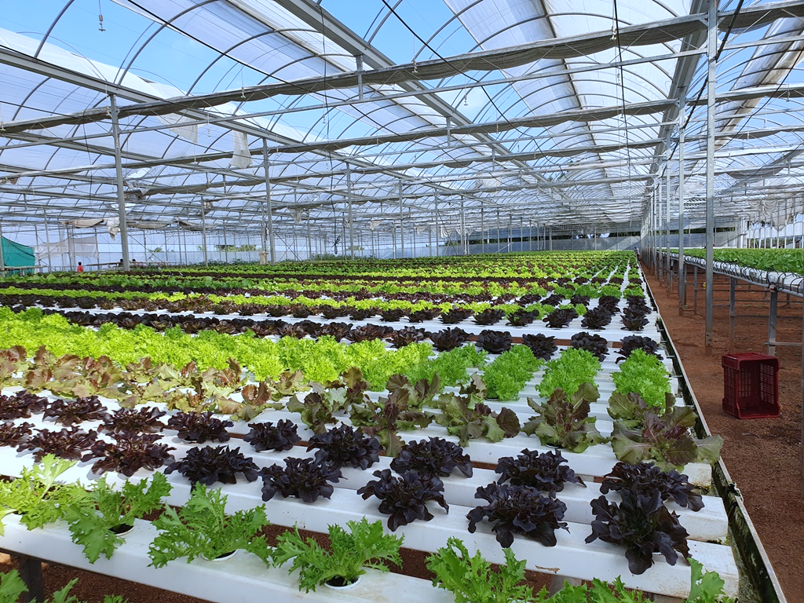
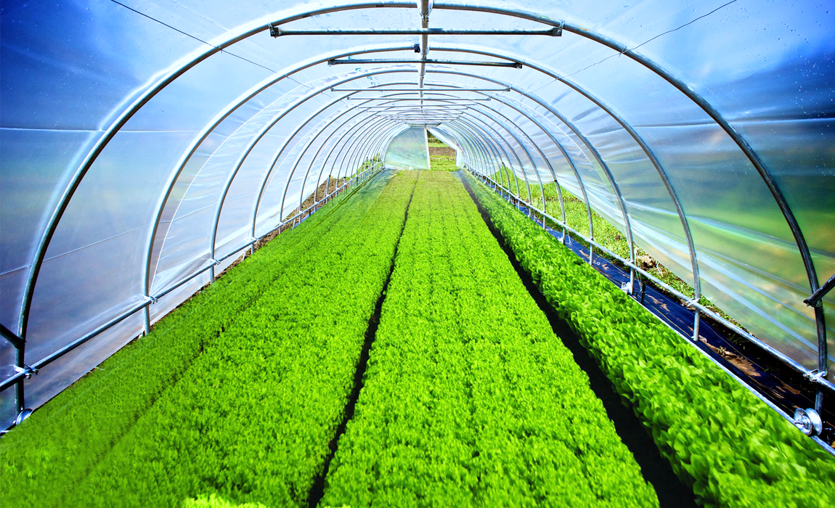

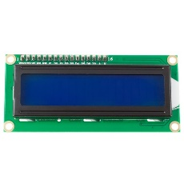

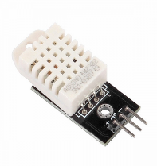
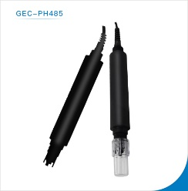
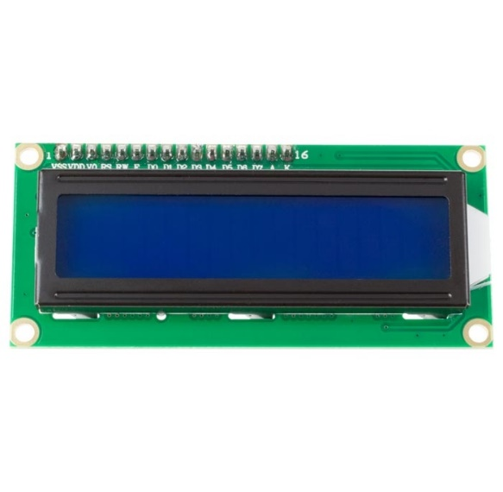
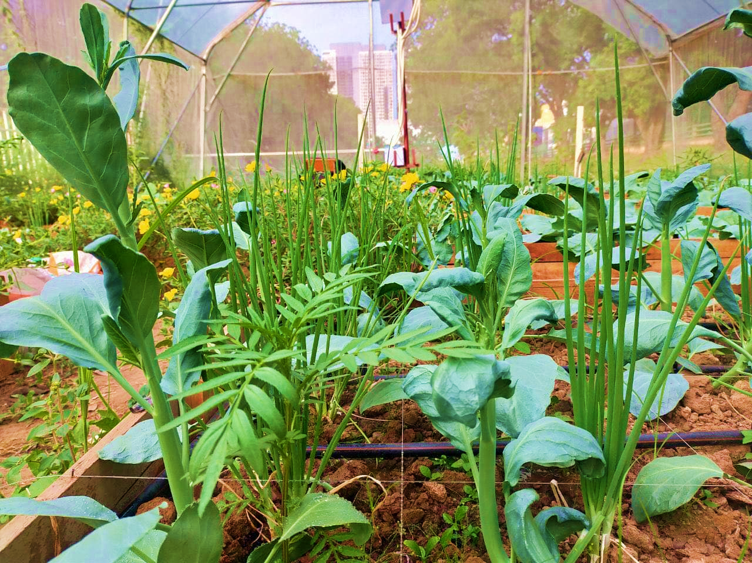

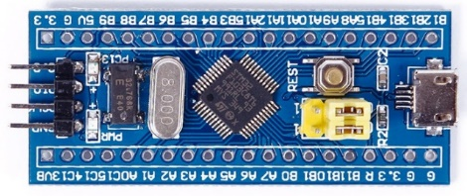

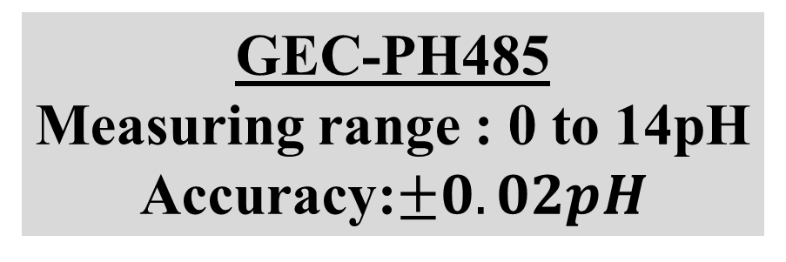
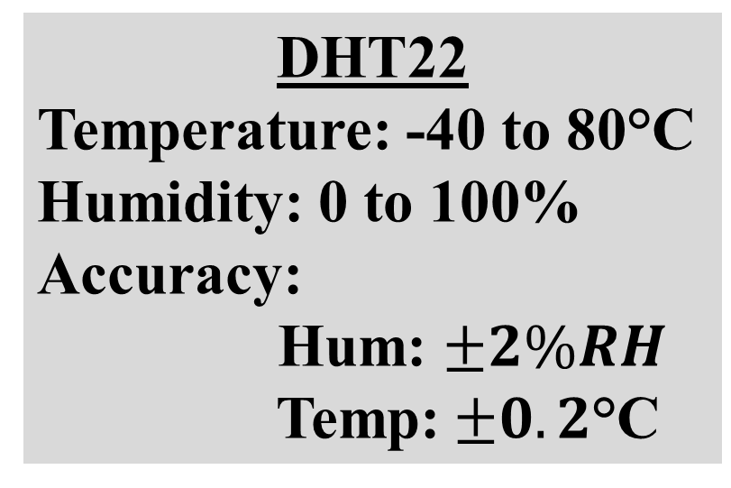
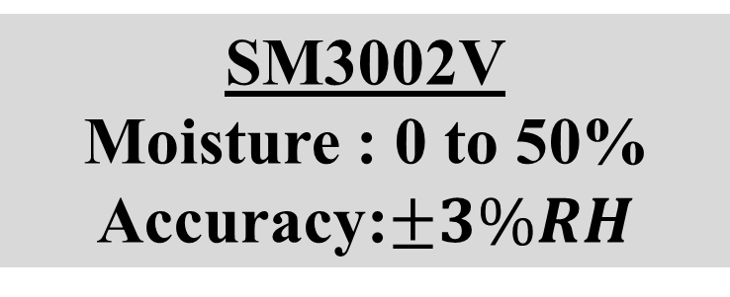
INSTITUTE OF TECHNOLOGY OF CAMBODIA
Department of Telecommunication and Network Engineering
MULTI-FUNCTION TESTER
INTRODUCTION
The main parameters that famer wants to measure for plant in their farm are Humidity, Temperature, Moisture and Soil’s pH, but it’s so difficult to measure and control those parameters. Plants need the specific temperature, humidity and moisture to grow faster and more yield. This project aims to support to farmer to measure those data in their farm or greenhouse.
Hum:%
OBJECTIVE
pH : 6.7
Hum : 67%
Temp:°C
Moi : 50%
Temp : 28°C
pH
Our project is a part of Agriculture and Technology. We plan to build simple Multi-Function Tester to help farmer to measure the data of Temperature, Humidity, Moisture and Soil’s pH in the farm.
pH
Moi
pH : 6.7
Hum : 67 %
Moi:%
Moi : 50%
Temp : 28°C
pH
pH
Moi
ON/OFF
SENSOR
pH : 6.7
Hum : 67%
Moi : 50%
Temp : 28°C
pH
Moi
Fig1: Measuring Sensor in Greenhouse
SYSTEM ARCHITECTURE
Multi-Function Tester is a device that can measure the temperature, humidity, soil moisture and soil’s pH from the farm or greenhouse. Main components of this tester consist of one micro-controller(STM32F103C8) with 3 sensors and a LCD. There are three buttons on Multi-Function Tester. One button is used for turning on and turning off and another used to read data from sensor. Multi-Function Tester can also function as a weather station and test-toolkit too. It’s small and we can use it with battery and power supply. So, it’s easier for famer to use it.
Fig3: Sample of Multi-Function Tester
CONCLUSION
Multi-Function Tester can use in many situation such as:
Garden: can be a weather station.
Farm: can be a weather station and tester.
Greenhouse: can be a weather station and tester.
Field: can be a weather station
Lab: can be a tester.
LCD 1602I2C
Display 16 rows and 2 columns
DHT22
Temperature: -40 to 80°C
Humidity: 0 to 100%
Accuracy:
Hum: $±2\%RH$
Temp:$±0.2\text{°}\text{C}$
SM3002V
Moisture : 0 to 50%
Accuracy:$±3\%RH$
CONTACT
ADVISOR:
STUDENT: NHIM Chanrengsey
Email: nhimchanrengsey@gmail.com
Tel: 070562483
GitHub: https://github.com/Chanthan89/Smart-Irrigation/tree/master/Multi-Function%20Tester
HEL Chanthan
CHHORN Sopheaktra
TEP Sovichea
GEC-PH485
Measuring range : 0 to 14pH
Accuracy:$±0.02pH$
Fig2: Main Components of Multi-Function Tester

